Slide 1
App Inventor
the easiest way to develop apps

Slide 2
What is
MIT App Inventor?
MIT App Inventor or App Inventor is a web platform where we can design and program an App for our mobile devices.
Url: ai2.appinventor.mit.edu

Slide 3
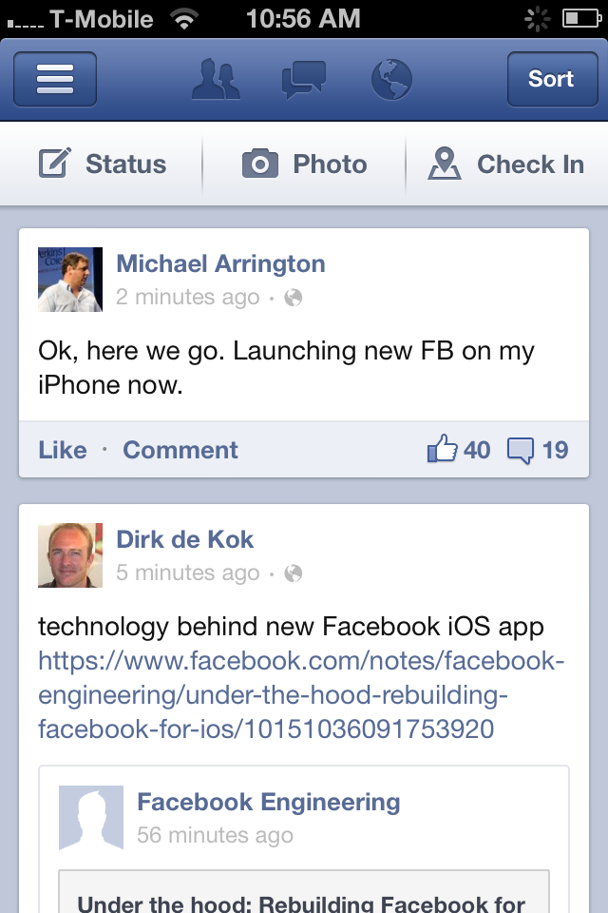
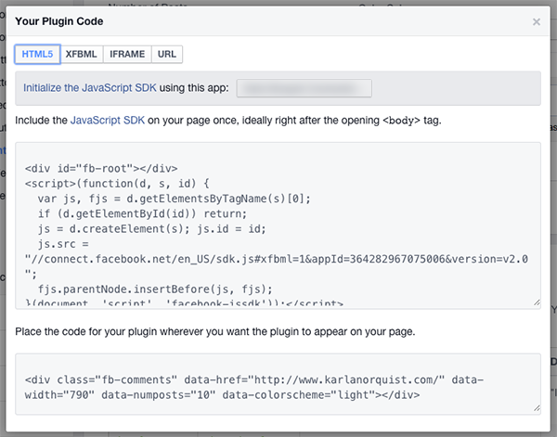
What is an App?
Graphical part
Codified part
Visible
Not Visible

Slide 4
About App Inventor
1) When we make an App, it will be only for Android devices.
4) You need a Google account
2) MIT App Inventor is Open Source,
it’s free!
5) App Inventor is user-friendly
3) To create an app you don’t need any sort of programming languages

Slide 5
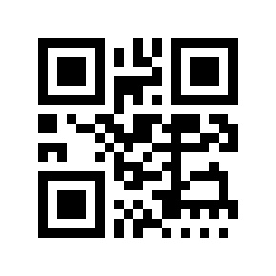
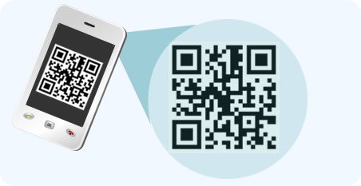
Real-time Updates
This is possible because a QR code can
communicate with your device.
QR codes can be read using smartphones,
that link directly to texts, emails, websites,
phone numbers and much more.

Slide 6
Start a New Project
When we open App Inventor we just see three buttons:
Start new project
Delete Project
Publish to Gallery

Slide 7
Let’s Name It !
We need a name for our first project so we can recognize it…!

Slide 8
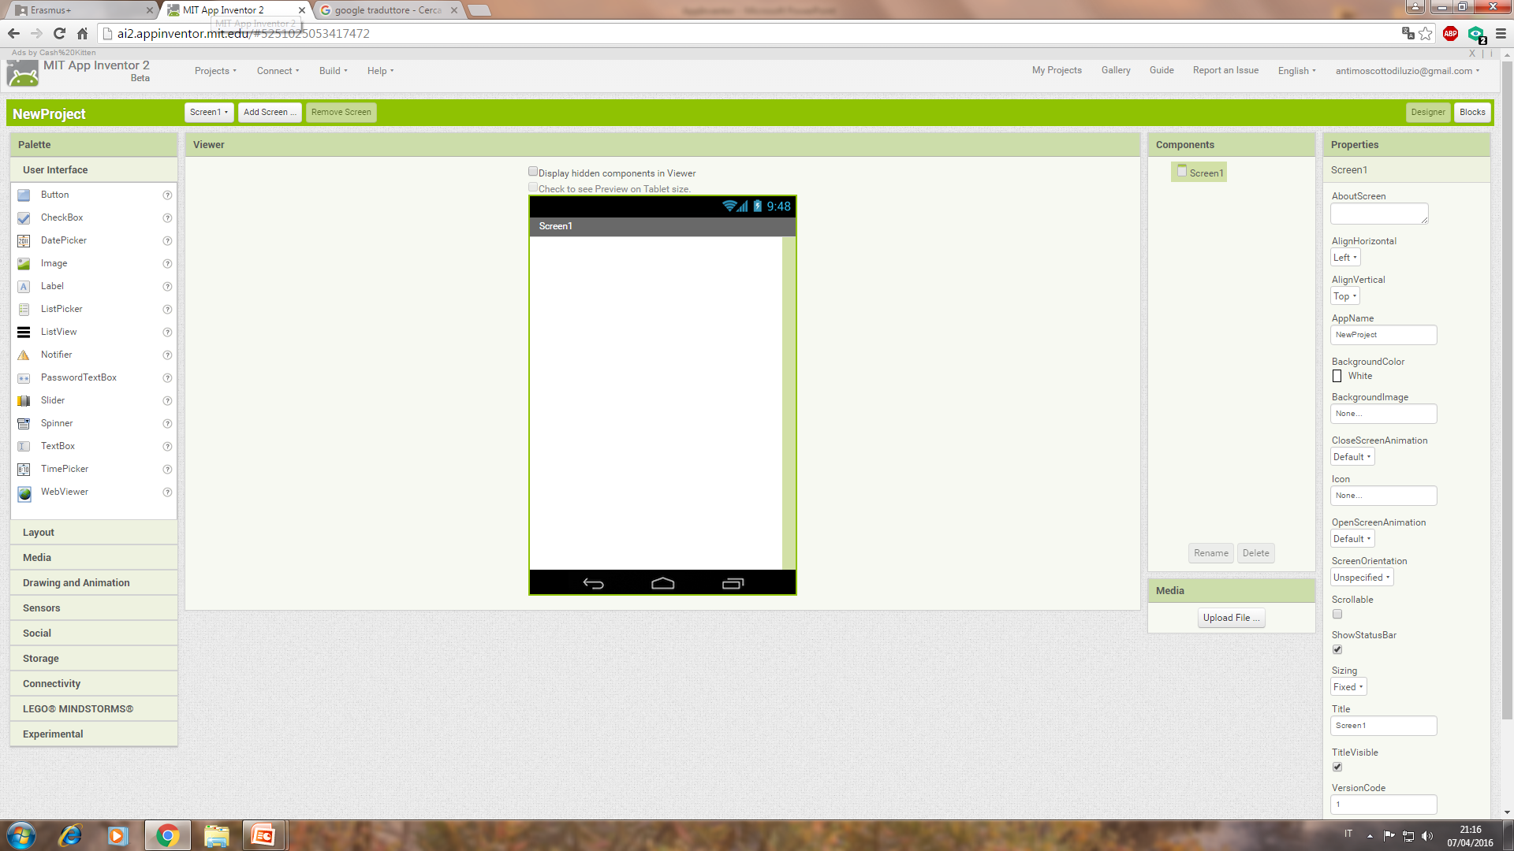
The Designer
Palette
Viewer
Components
Properties

Slide 9
The Palette
The Palette contains all we can put in our app.
There are 8 categories of items we can use:
User Interface
Layout
Media
Drawing and Animation
Sensors
Social
Storage
Connectivity

Slide 10
The Viewer
The Viewer is the graphical part of App Inventor and shows us in real-time what is happening to our app and how it looks like.

Slide 11
The Components
Here you can see all the items in your app, rename or delete them, or just upload files.

Slide 12
The Properties
In the Properties space you can control your components and set their color, font size, height, width etc...

Slide 13
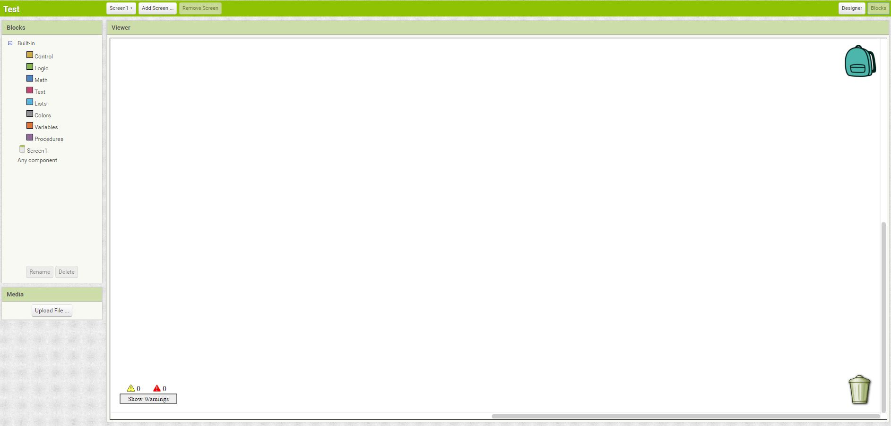
The Blocks Screen
Blocks
Viewer

Slide 14
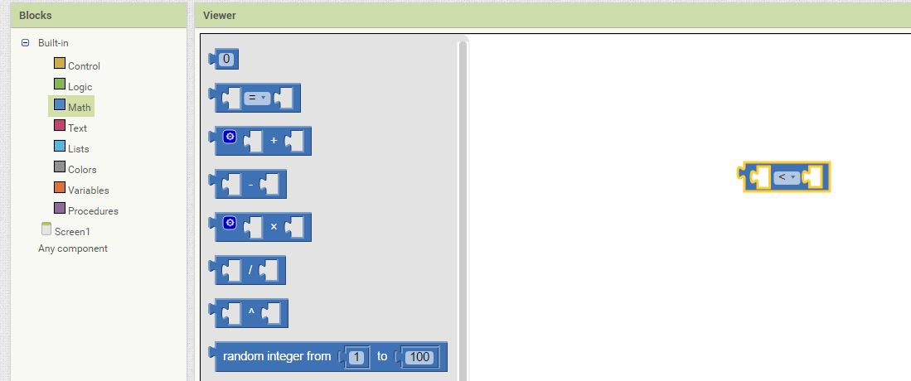
How to Do
It is very simple! You just have to drag the block you have chosen into the Viewer and then link it to another block matching their ends, just like a puzzle!

Slide 15
The Blocks
There are several kinds of blocks you can use:
Control
Logic
Math
Text
Lists
Colors
Variables
Procedures

Slide 16
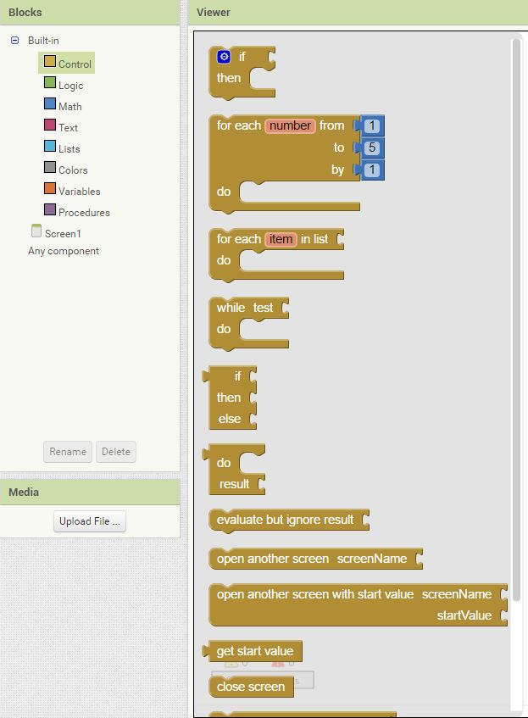
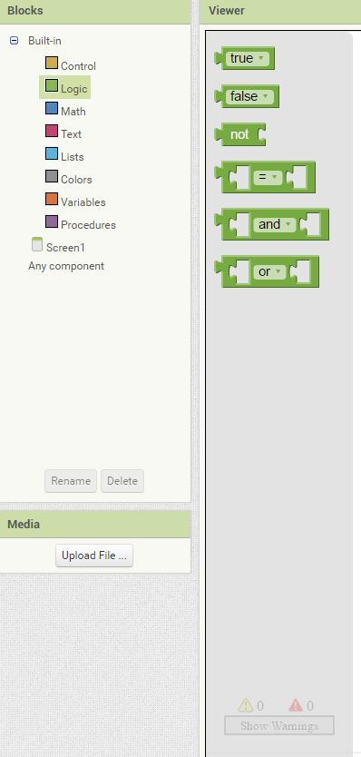
Control and Logic Blocks
With Control Blocks you can set the actions that will be done in the app.
For example, with the first block, you can do something if a condition is true.
But, how to set a condition?
With a Logic block of course!
For example, we can choose to make an action happen when two numbers are identical.

Slide 17
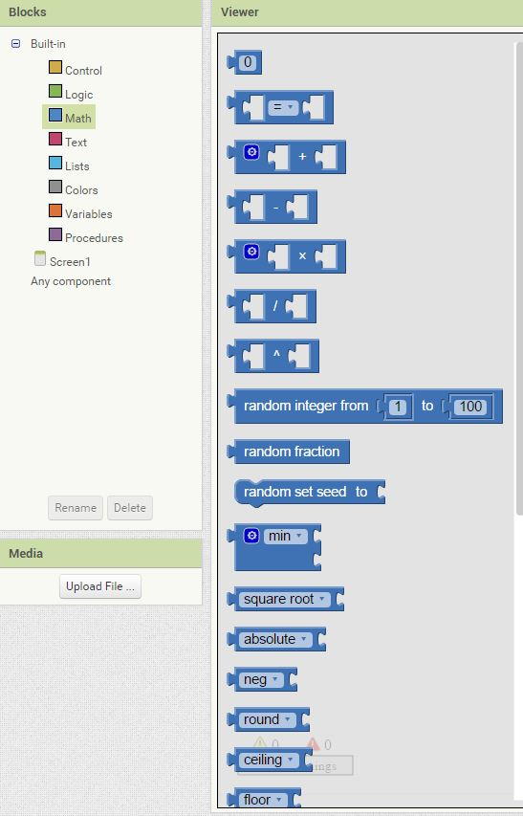
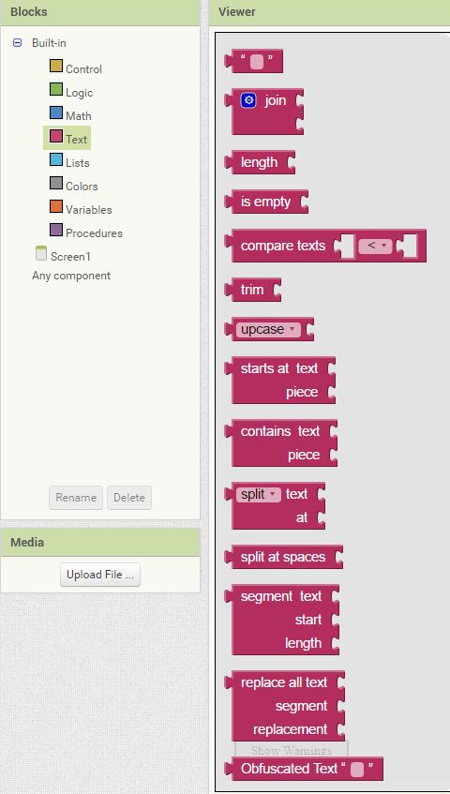
Math and Text Blocks
With a Math Block you can do mathematical operations such as additions or multiplications.
But you can also generate a random number.
A Text Block can allow you to add a text or, for example, compare words, but you can also convert a text to uppercase or lowercase.

Slide 18
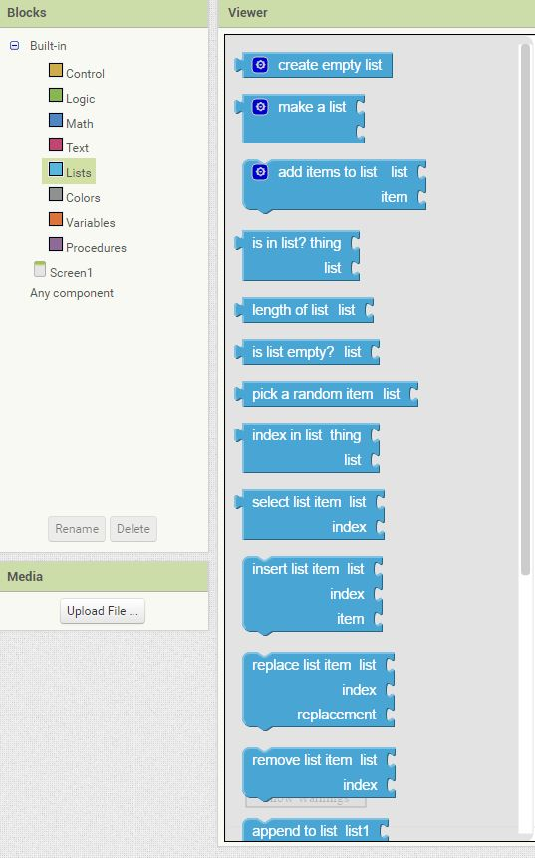
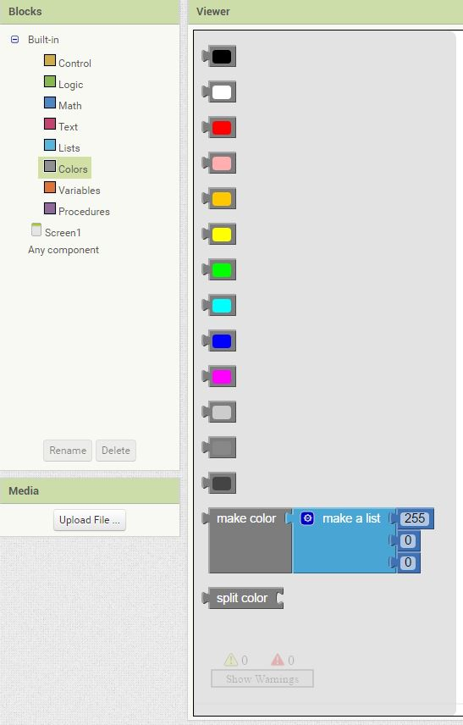
Lists and Colors Blocks
Lists Block allows us to create lists of data. For example, Facebook app keeps a list of all our friends. We can keep a list of inserted data.
And with Colors Block we can set the color of any component.

Slide 19
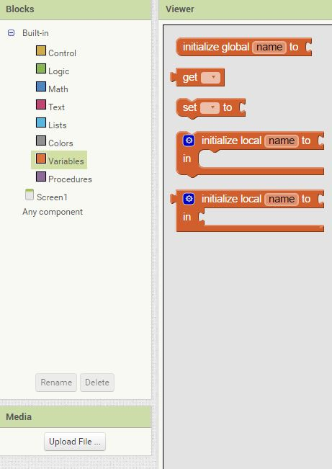
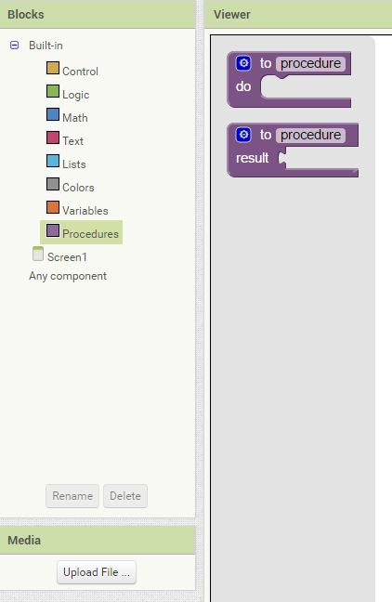
Variables and Procedures
Variables are data that can change, and usually they are numbers.
Procedures are a set of instructions executed step by step.
In App Inventor a procedure is a collection of blocks.

Slide 20
Made by:
Gioele Costagliola
Antimo Scotto di Luzio
Marco Varchetta

